Slide 1
Houston Baptist University
Version 8.1.4

Slide 2
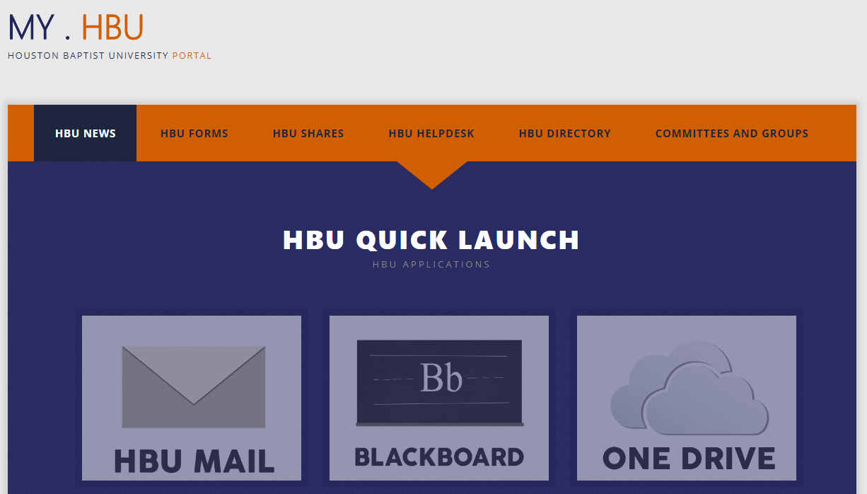
Single sign on from HBU Portal
Log into your HBU portal at my.hbu.edu
Click onto “Schedule an Event”

Slide 3
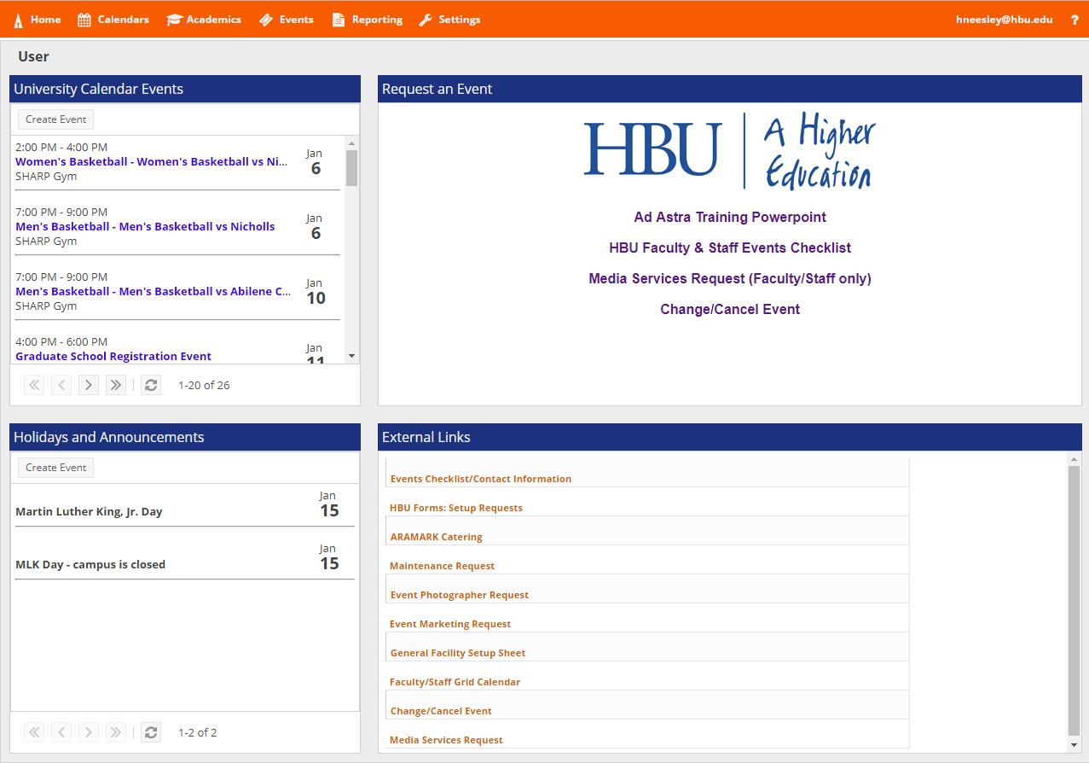
Select sign in on the top left.
Username is email excluding @hbu.edu. (ex. hneesley@hbu.edu)

Slide 4
Ad Astra specific links for Ad Astra Training, Faculty & Staff Checklist, Media Request form, and Changing/
Canceling Event

Slide 5
Calendars for events that are featured on the HBU University calendar.

Slide 6
Helpful external links to help plan your event!

Slide 7
Calendars

Slide 8
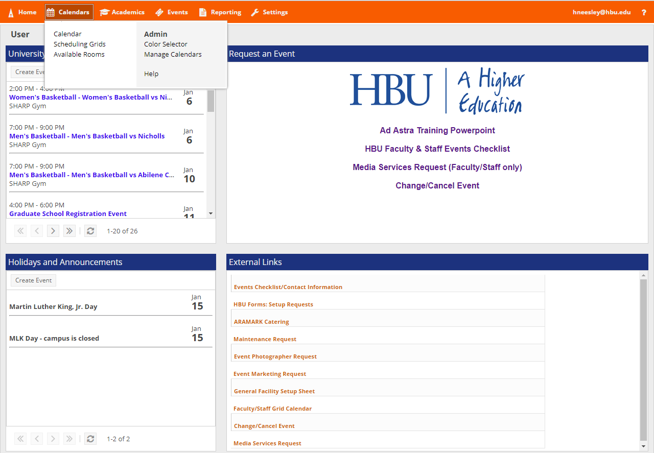
Select “Calendars” to view the Activity calendar, scheduling grids, and available rooms.

Slide 9
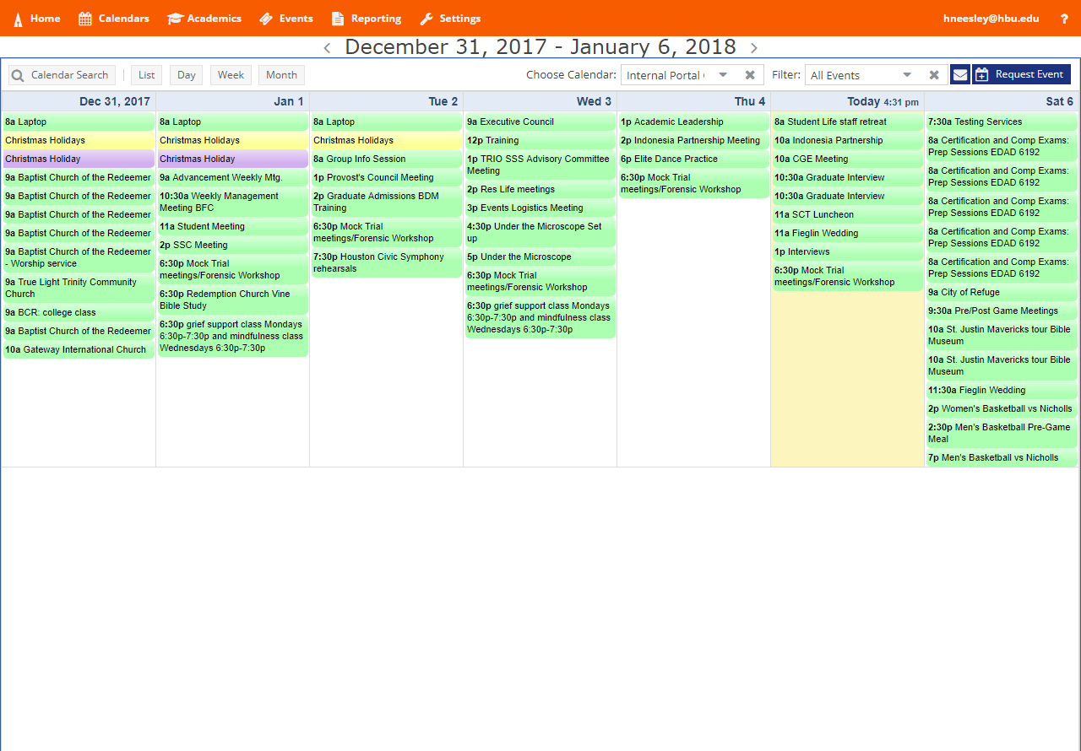
Activity Calendar
Lists Day, Week, or Month events.

Slide 10
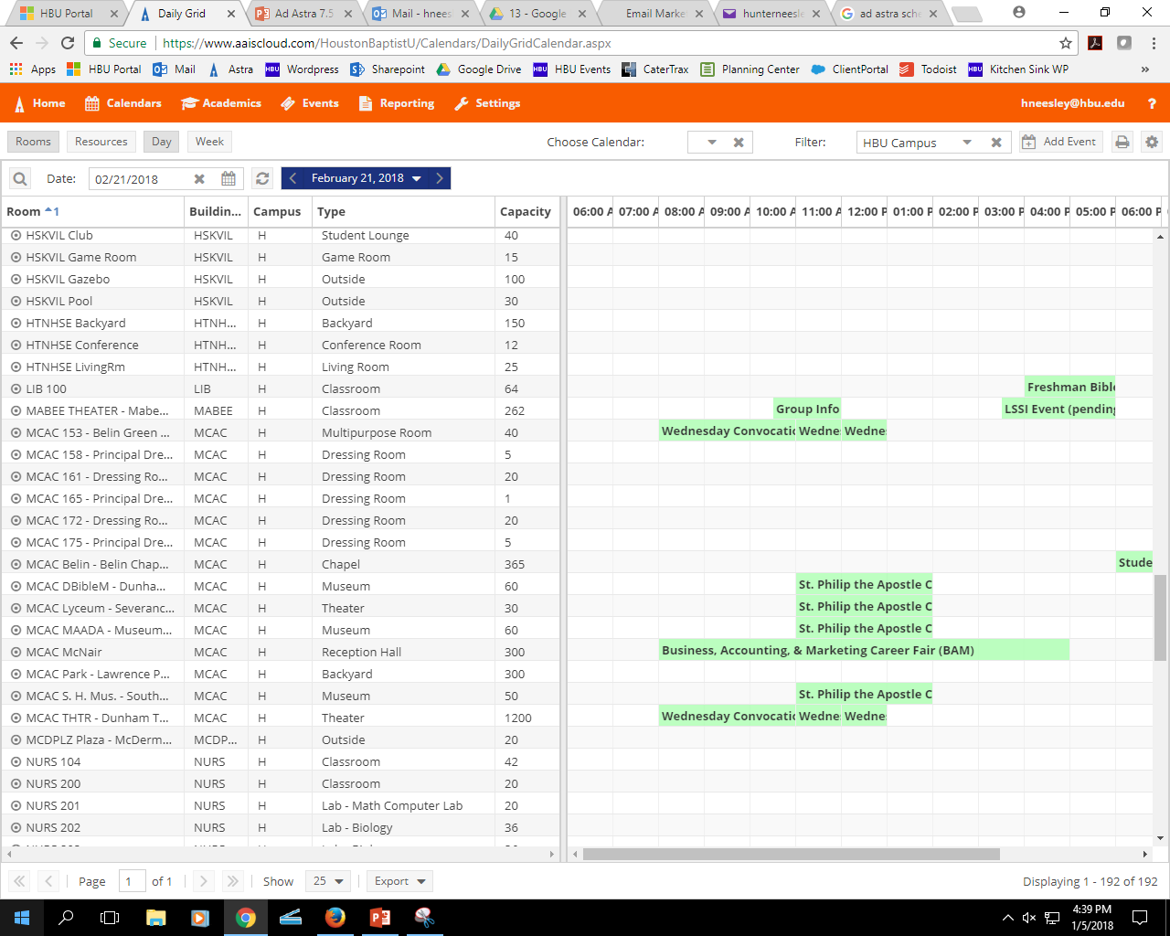
Scheduling Grids
Views all rooms for a specific day
Or
One room for a week.

Slide 11
Event Request

Slide 12
Select “Events” to view events and request an event.

Slide 13
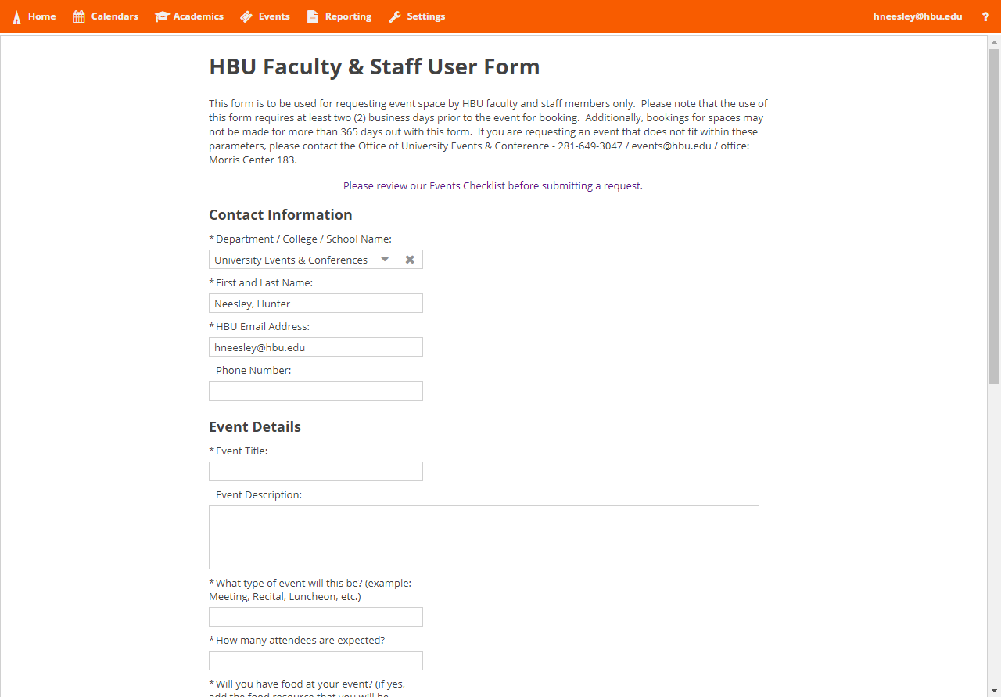
Event Request Form
Link to Faculty and Staff Event Checklist

Slide 14
Event Request Form

Slide 15
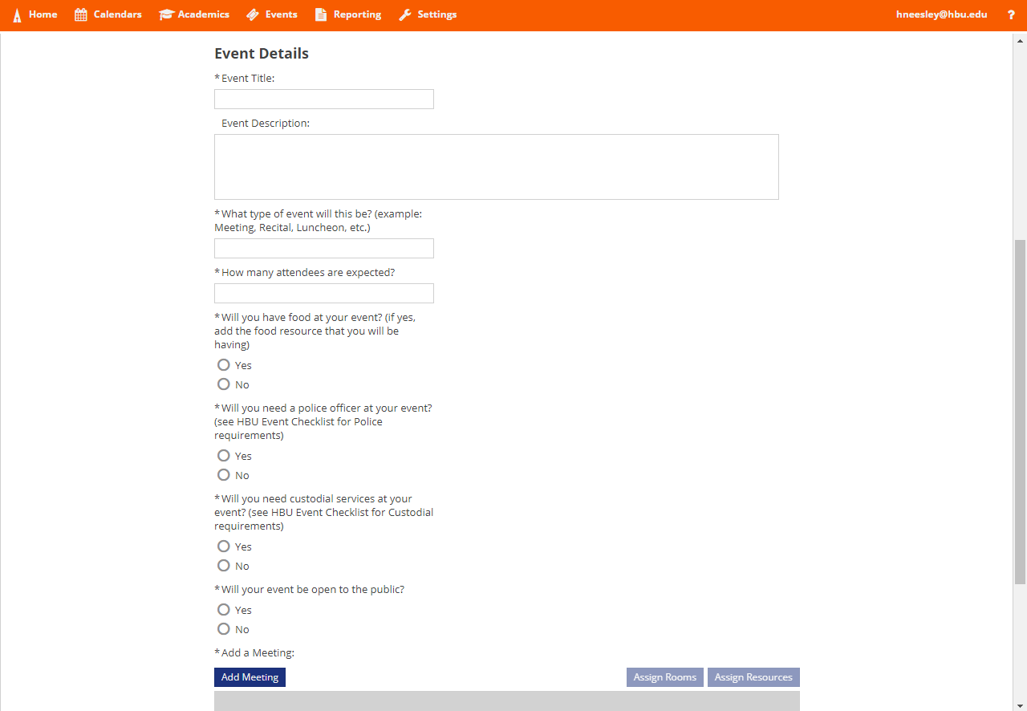
Event Request Form
Complete the Event Details about your reservation.

Slide 16
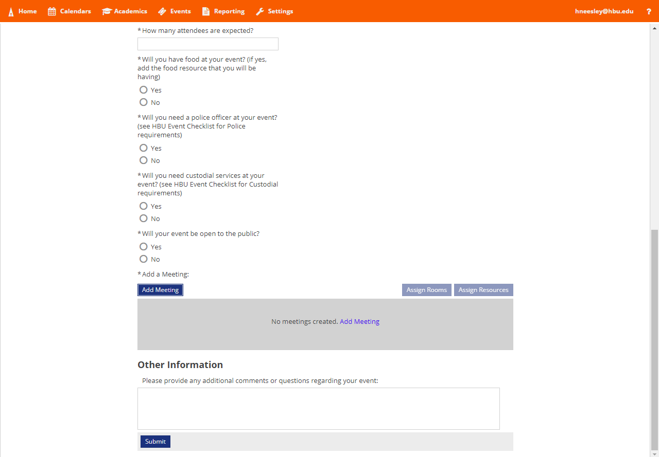
Event Request Form
Select “Add Meeting”

Slide 17
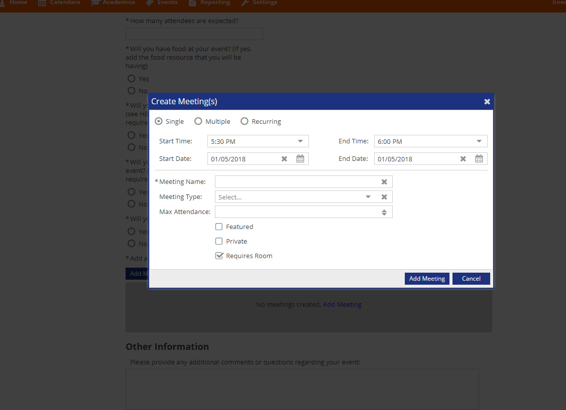
Event Request Form
Can request single, multiple, or reoccurring meetings.

Slide 18
Event Request- Single Meetings

Slide 19
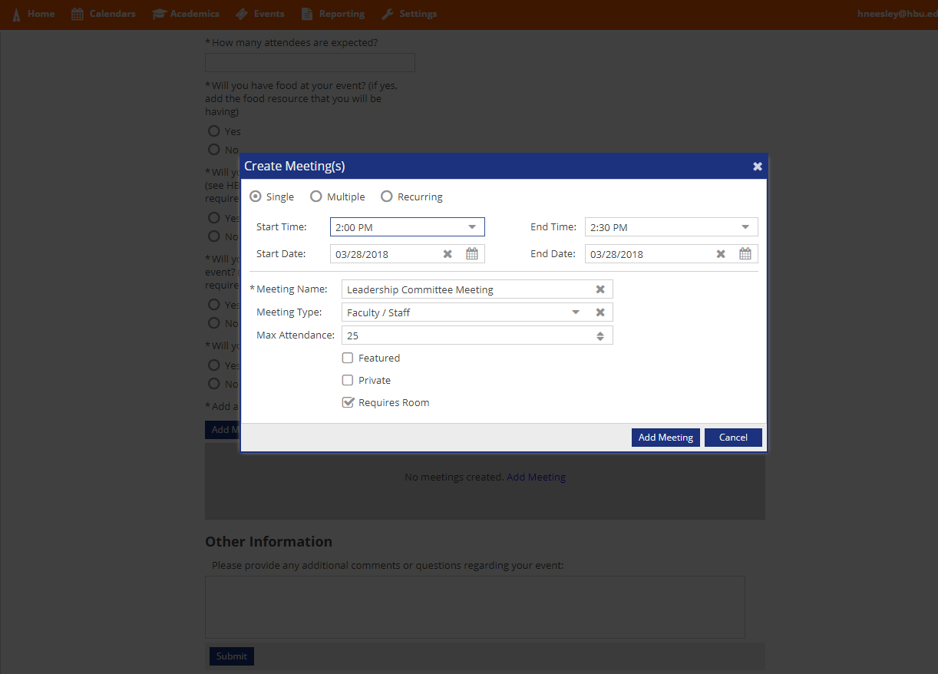
Event Request Form- Single Meetings
Fill out information for a single meeting.
Select “Add Meeting”.

Slide 20
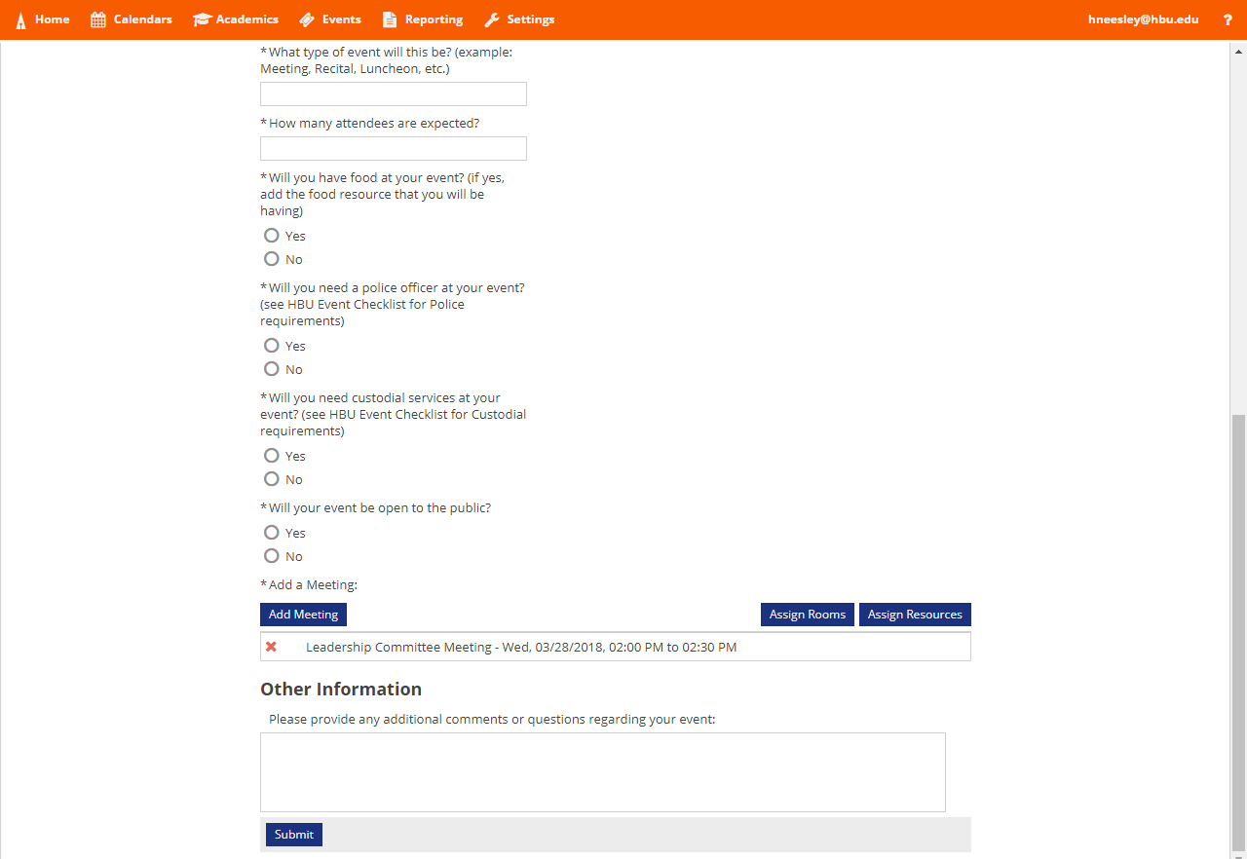
Event Request Form- Single Meetings
Meeting name, date, and time has been added to the reservation request.

Slide 21
Event Request- Multiple Meetings

Slide 22
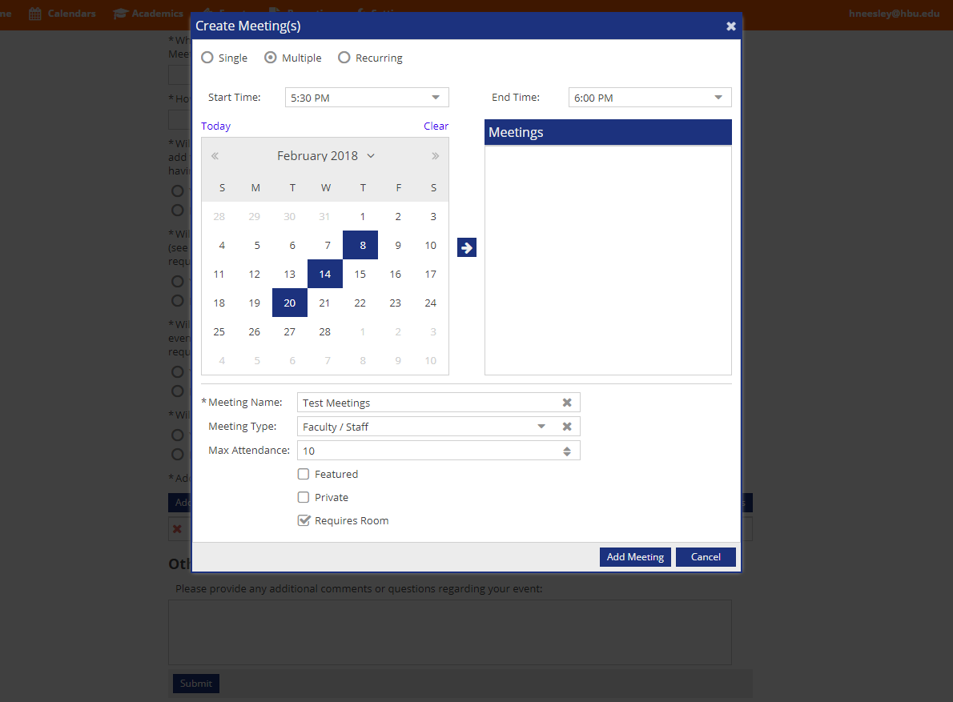
Event Request Form- Multiple Meetings
Fill out information for multiple meetings.
Select the arrow.

Slide 23
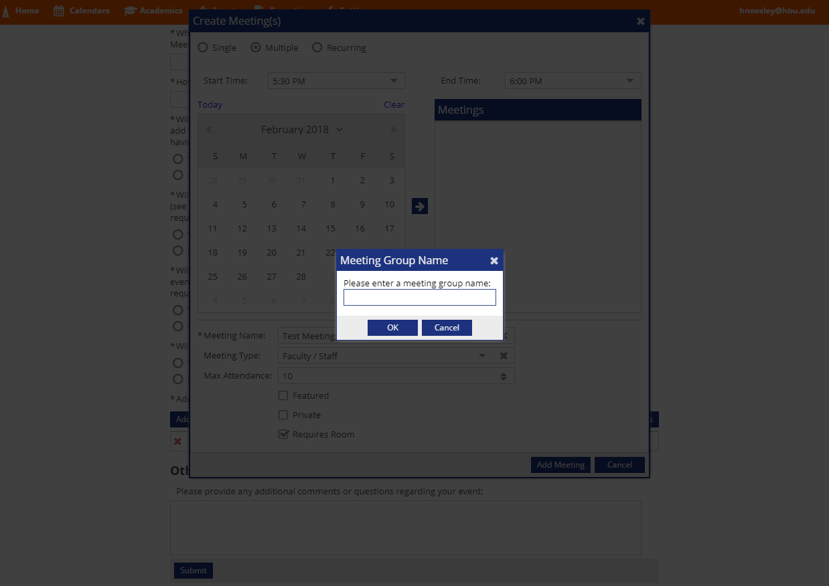
Event Request Form- Multiple Meetings
Choose a name for the group of dates.

Slide 24
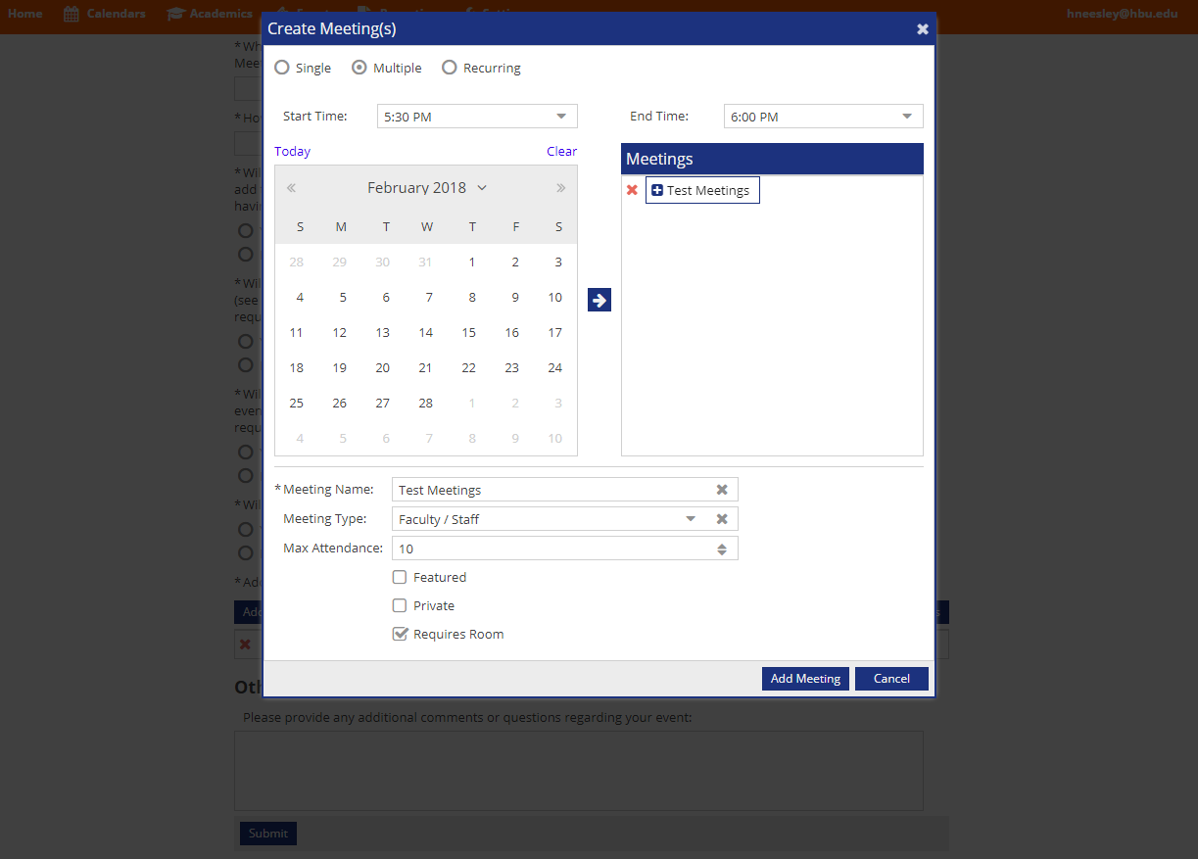
Event Request Form- Multiple Meetings
Select the plus sign to expand the group and show all dates.

Slide 25
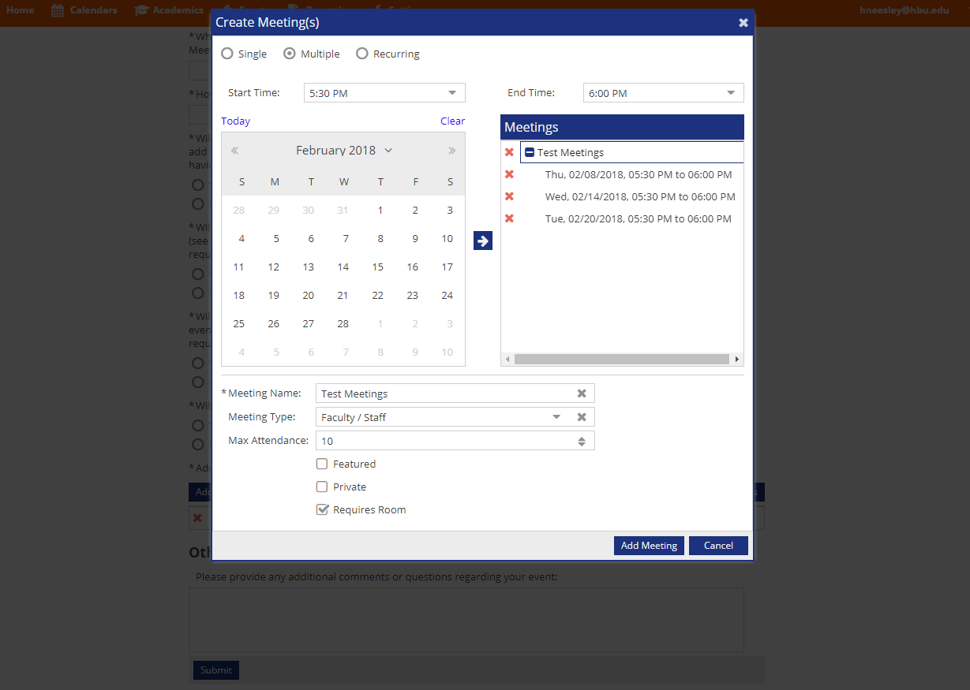
Event Request Form- Multiple Meetings
Check to make sure all the meetings are correct.
Click the red X to delete any unwanted meetings.

Slide 26
Event Request Form- Multiple Meetings
Select “Add Meeting”.

Slide 27
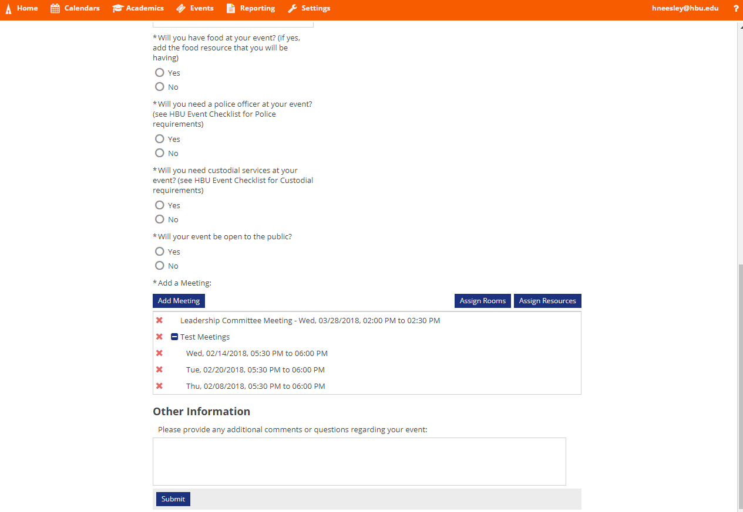
Event Request Form- Multiple Meetings
Meeting name, date, and time has been added to the reservation request.

Slide 28
Event Request- Reoccurring Meetings

Slide 29
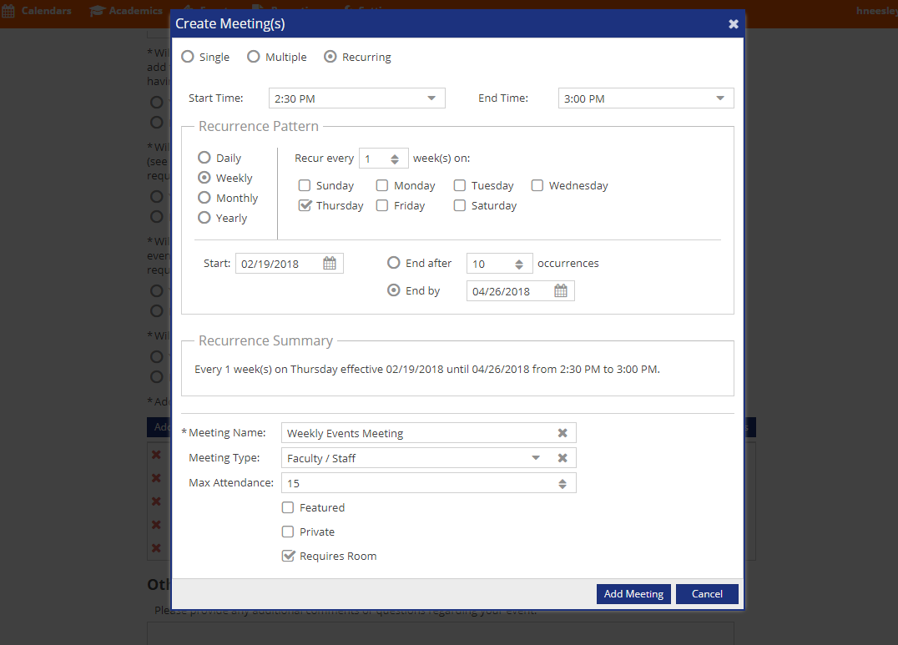
Event Request Form- Reoccurring Meetings
Fill out information for reoccurring meetings.
Check the “Recurrence Summary” to make sure it is correct.

Slide 30
Event Request Form- Reoccurring Meetings
Select “Add Meeting”.

Slide 31
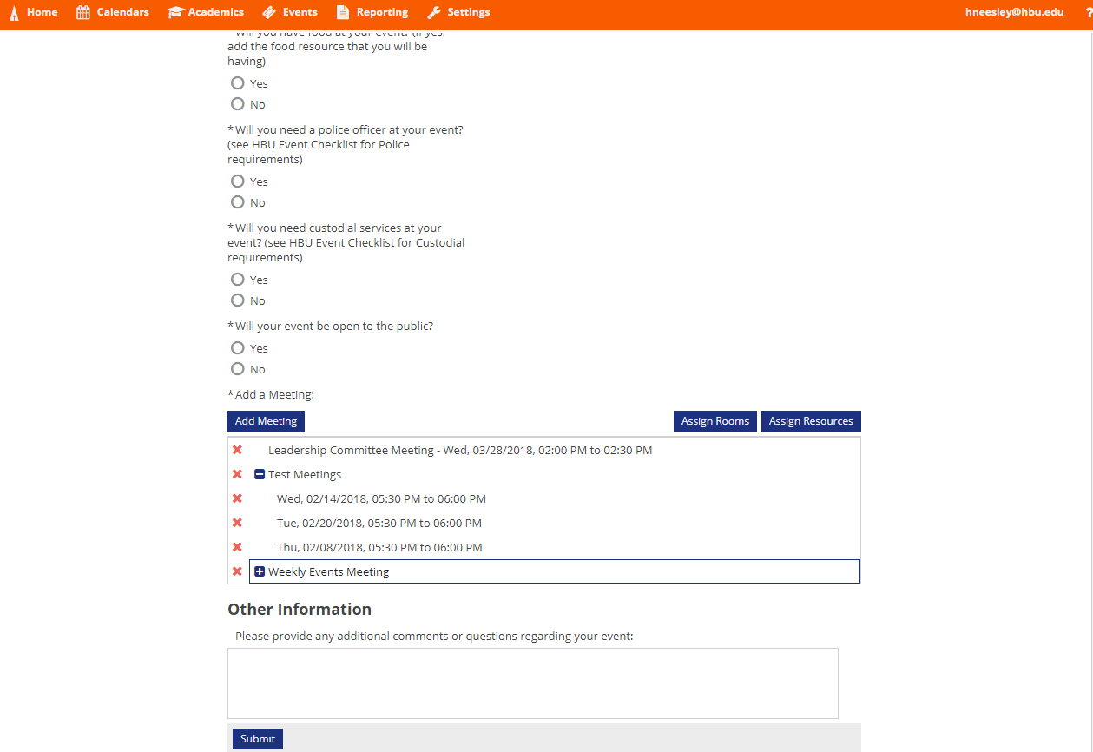
Event Request Form- Reoccurring Meetings
Meeting name, date, and time has been added to the reservation request.

Slide 32
Event Request- Requesting Rooms

Slide 33
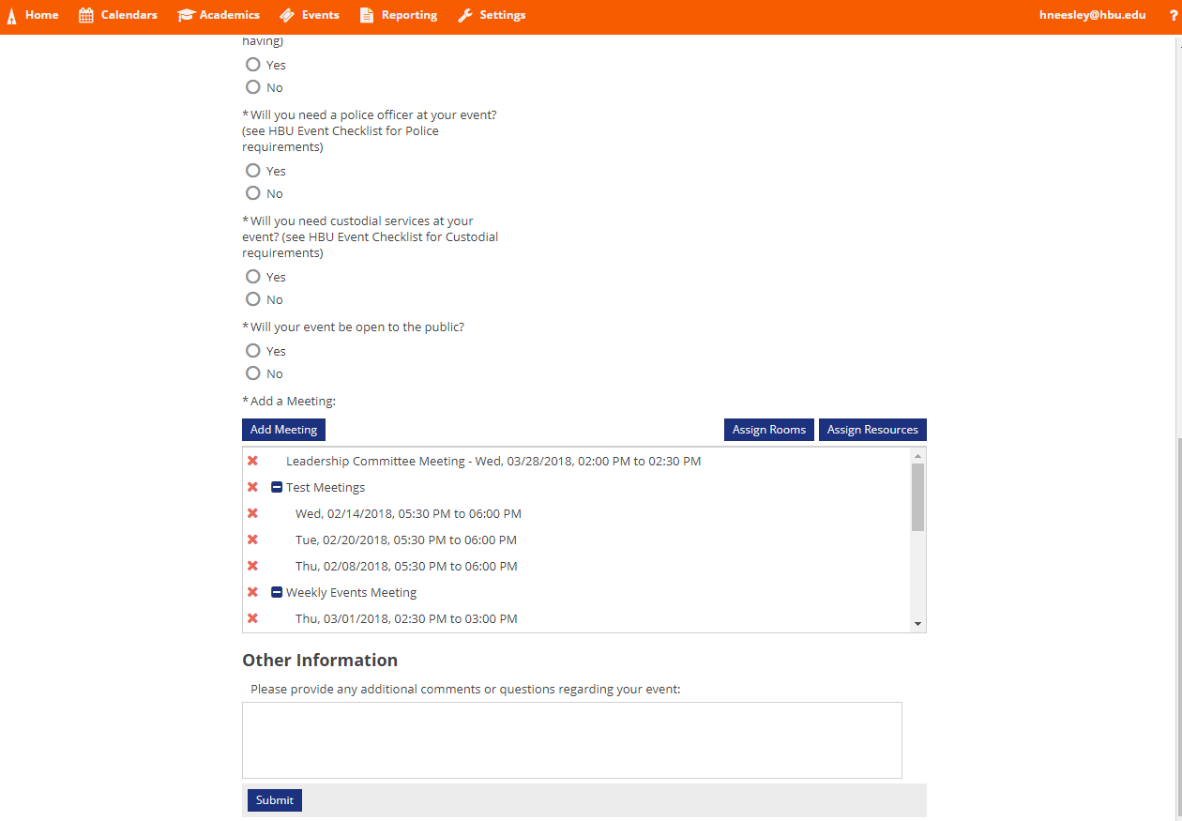
Event Request Form- Requesting Rooms
Select “Assign Rooms”

Slide 34
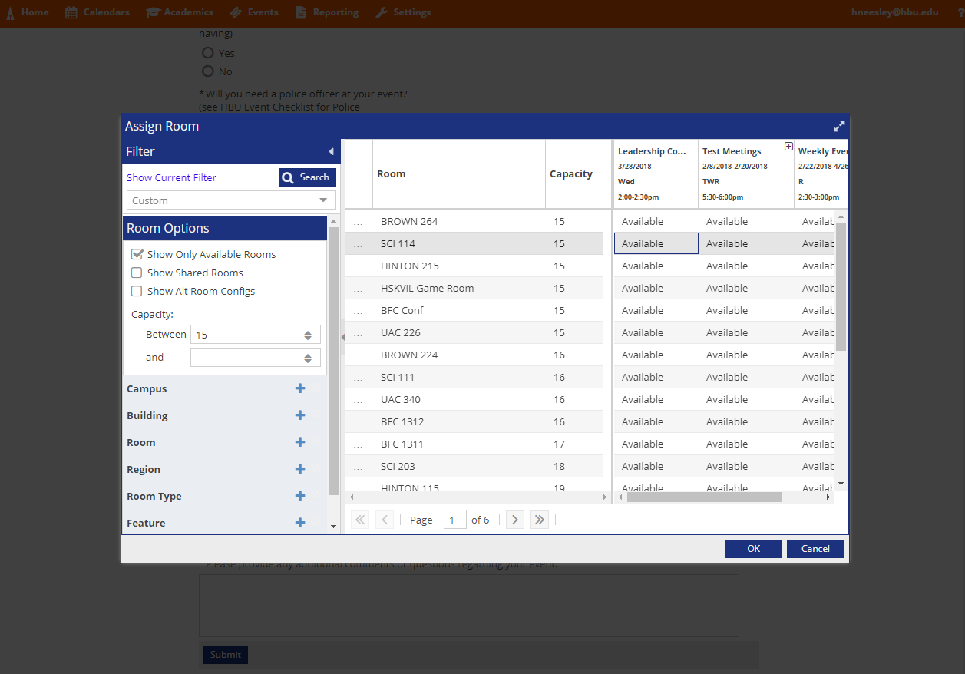
Event Request Form- Requesting Rooms
Meeting names are shown at the top.

Slide 35
Event Request Form- Requesting Rooms
Can filter by building, room type, or feature.
*note that only available rooms are selected.*

Slide 36
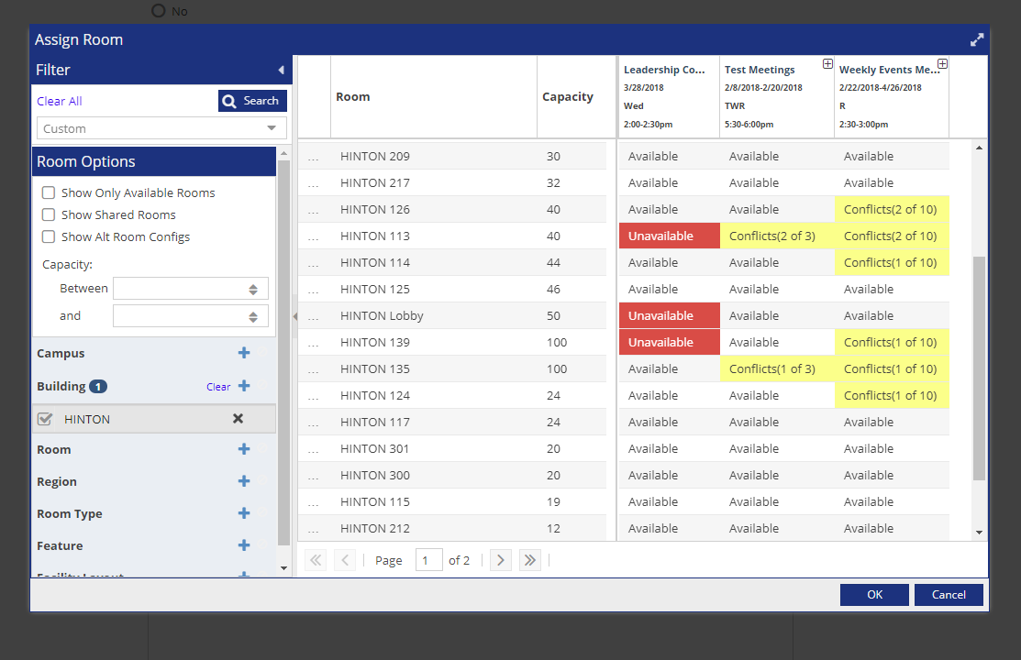
Event Request Form- Requesting Rooms
Shows rooms that are available, unavailable, or have conflicts.

Slide 37
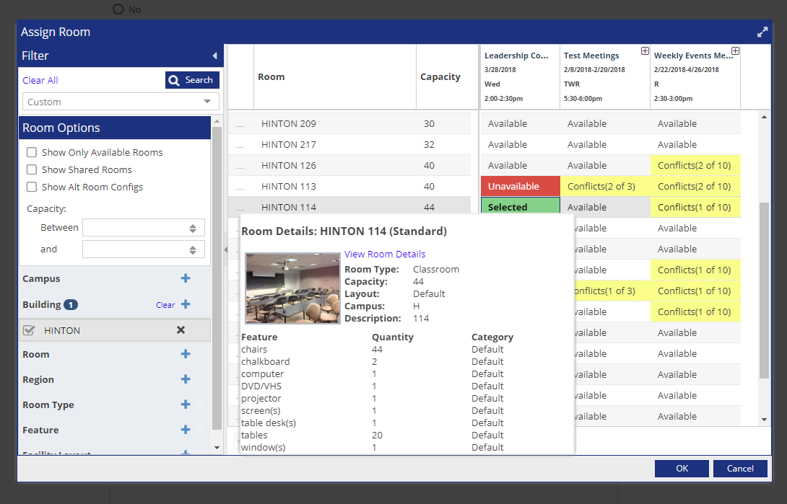
Event Request Form- Requesting Rooms
Can hover over the …. To see the rooms details.

Slide 38
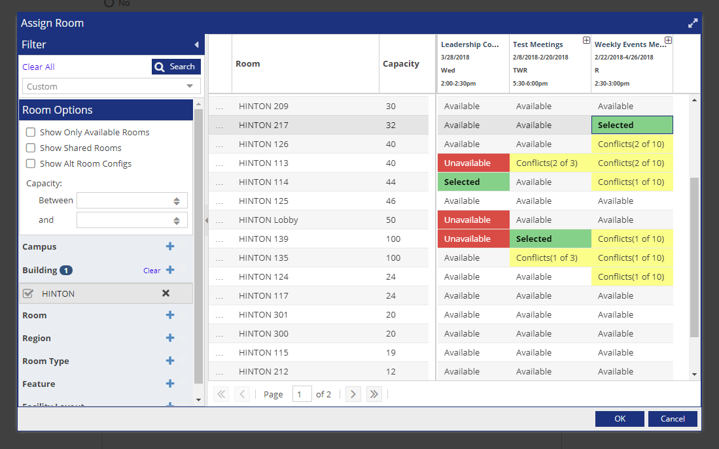
Event Request Form- Requesting Rooms
Select the rooms you would like to request.
Select “OK”

Slide 39
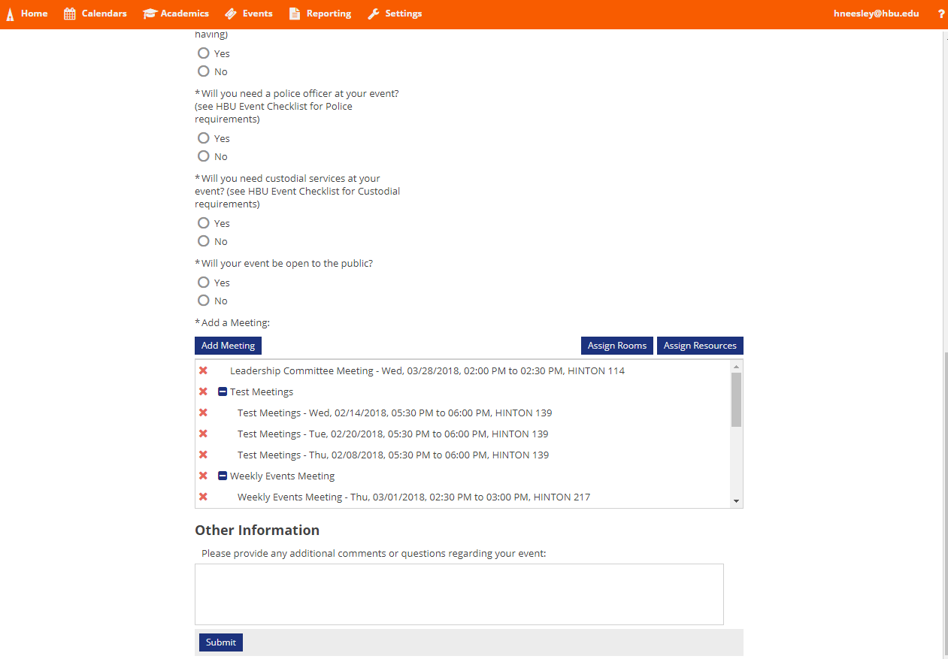
Event Request Form- Requesting Rooms
Check that rooms have been added to the meetings.

Slide 40
Event Request- Requesting Resources

Slide 41
Event Request Form- Requesting Resources
Select “Assign Resources”

Slide 42
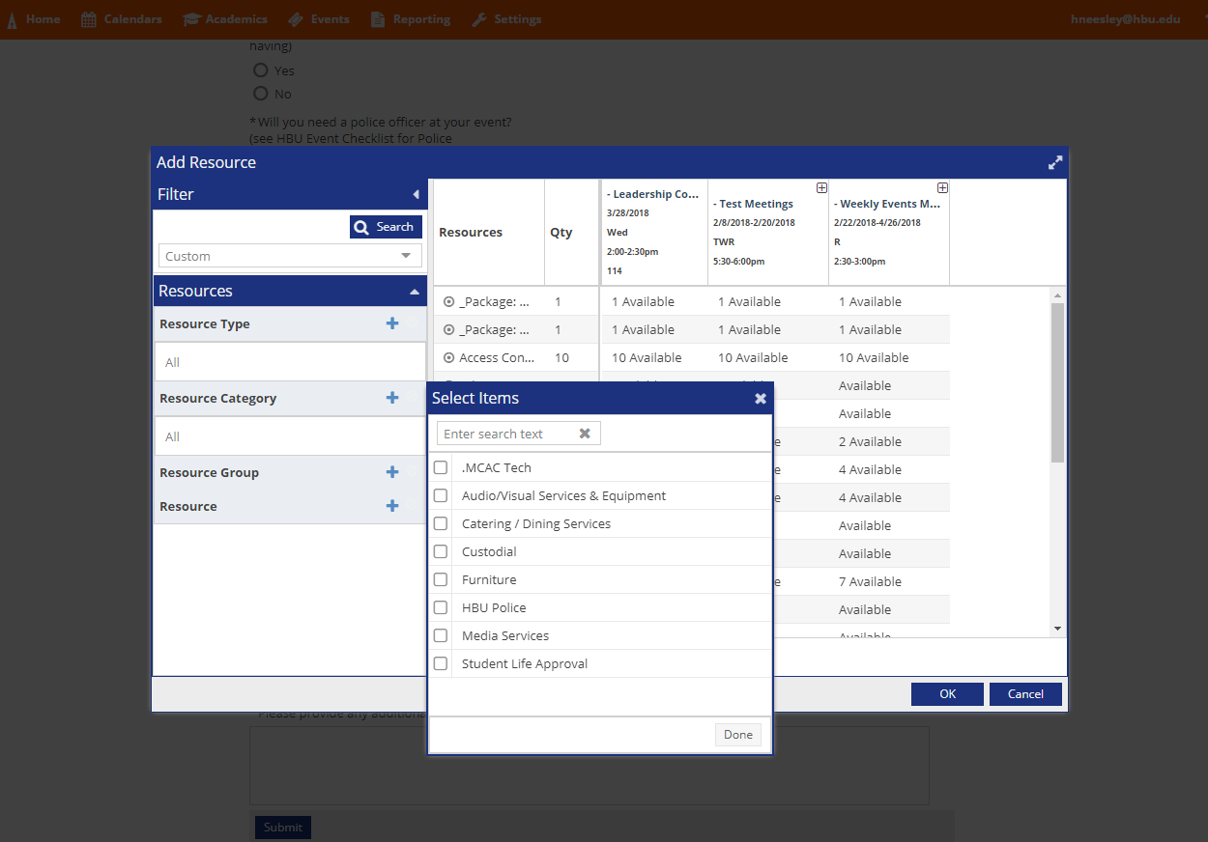
Event Request Form- Requesting Resources
Click the plus sign to filter by “Resource Category”

Slide 43
Event Request Form- Requesting Resources
Select the resource category you would like to filter by.

Slide 44
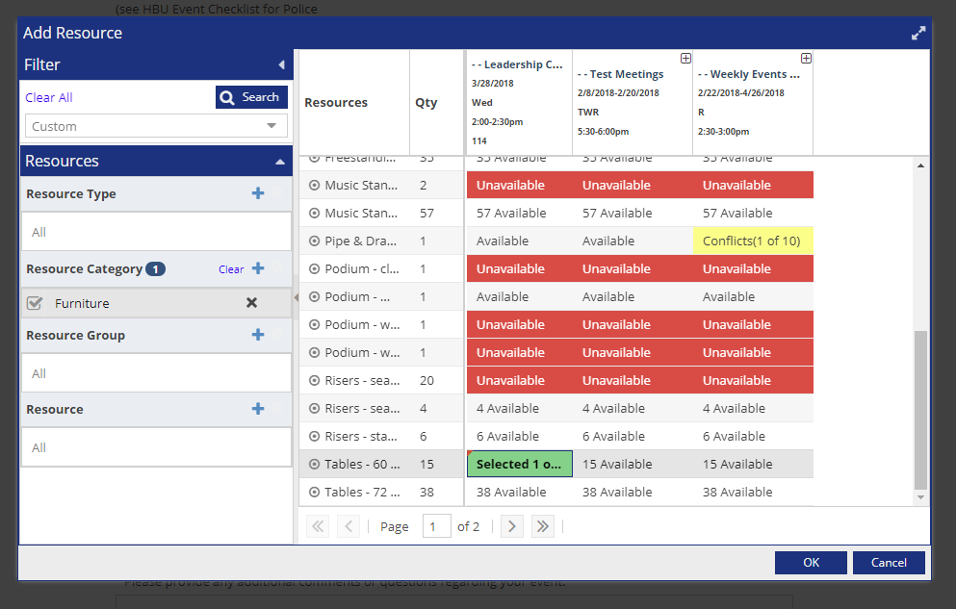
Event Request Form- Requesting Resources
Select the furniture that you will need for your event.
This secures the equipment inventory wise.
*Set up Request will still need to be submitted for all events needing furniture*

Slide 45
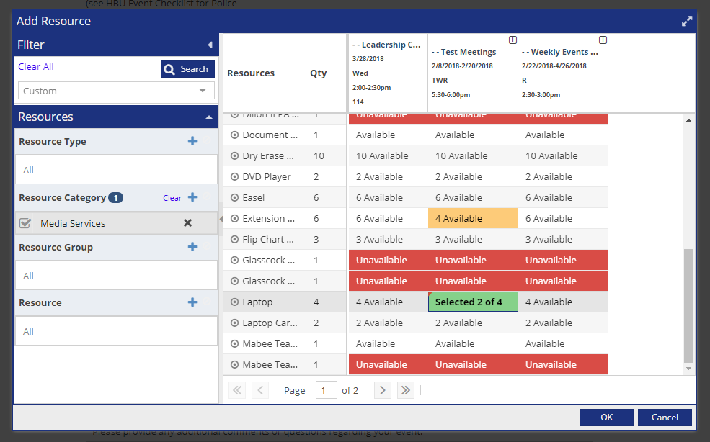
Event Request Form- Requesting Resources
Media can only be requested by Faculty and Staff.
Select the media services resource that you will need for your event.
*If Media Services resource is not requested here, you will have to fill out the Media Services Resource request form found on the Homepage of Ad Astra.*

Slide 46
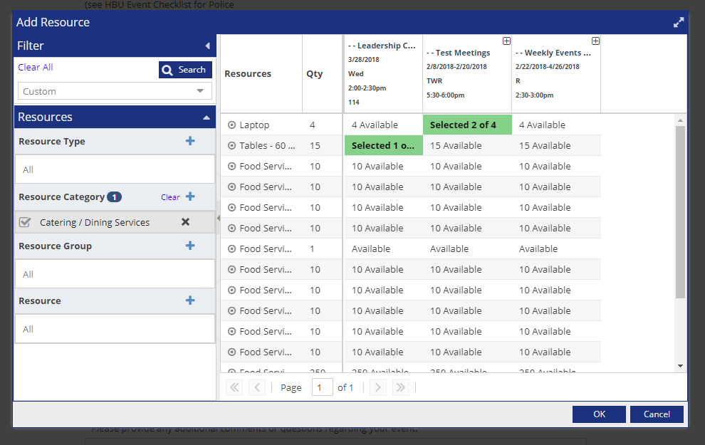
Event Request Form- Requesting Resources
Select Catering that you will be using.

Slide 47
Event Request Form- Requesting Resources
If any resources were previously selected, they will still show even after a new filter.

Slide 48
Event Request Form- Requesting Resources
Select “OK”

Slide 49
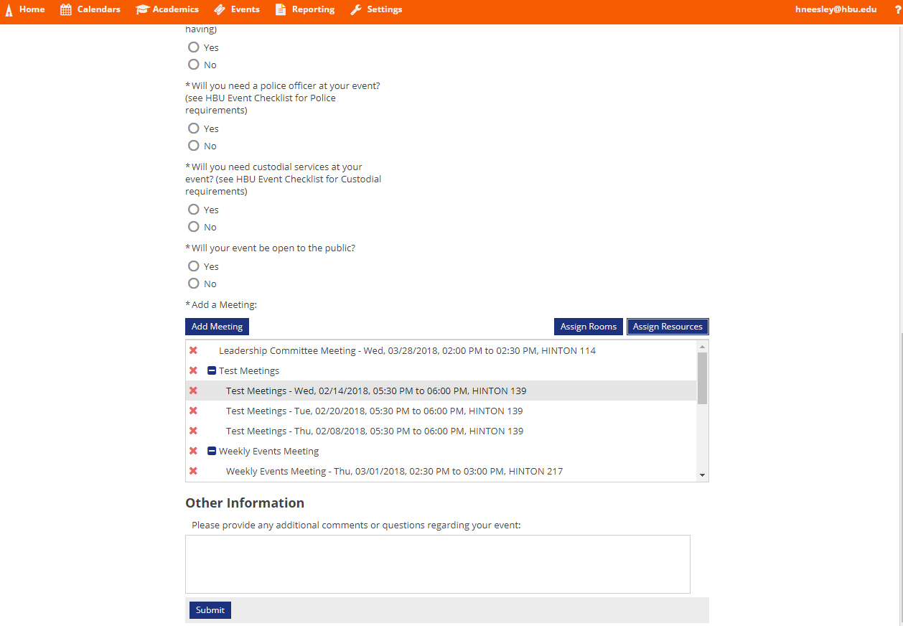
Event Request Form
Check to make sure all information is correct.
Select “Submit”.
*Resources will not appear on the form but that have been requested!*

Slide 50
Event Request Form
Select “Done” and you should receive a confirmation email that we have received your request.
*This screen and email does not mean the event has been event has been scheduled. You will receive an email that we have either approved or declined your request*

Slide 51
Brings you back to the homepage to have more fun!

